Slide 1
Soft Computing
Module II
Dr. Sreejith Rajan

Slide 2
McCulloch-Pitt Neuron
McCulloch–Pitts Neuron Model was formulated in the year by Warren Mc
Culloch and Walter Pitts in the year 1943.
It is characterised by its formalism, elegant and precise mathematical definition.
The neuron allows only the binary states i.e., ‘0’s and ‘1’s, so it is called as a
binary activated neuron.
These neurons are connected by direct weighted path. The connected path can be excitatory or inhibitory

Slide 3
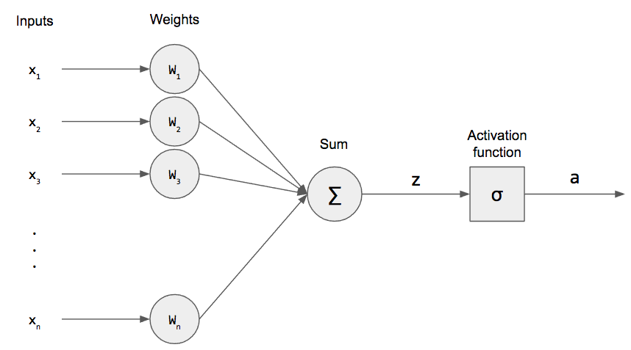
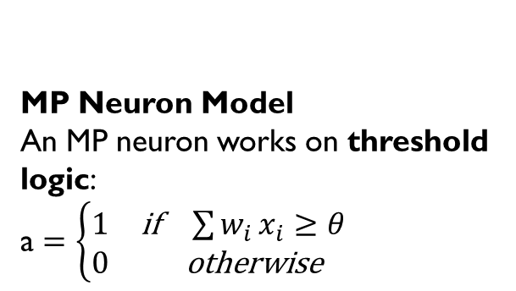
MP Neuron
MP Neuron Model
An MP neuron works on threshold logic:
a $=\left\{\begin{matrix}1 & \text{if} \sum{w_{i}}x_{i}≥θ \\ 0 & \text{otherwise}\end{matrix}\right.$

Slide 4
MP Neuron
Excitatory connections have positive weights and inhibitory connections have negative weights.
The neuron is associated with the Threshold value.
The neuron fires if the net input to the neuron is greater than the Threshold.
The threshold is set so that the inhibition is absolute, because the non-zero inhibitory output will prevent the neuron from firing

Slide 5
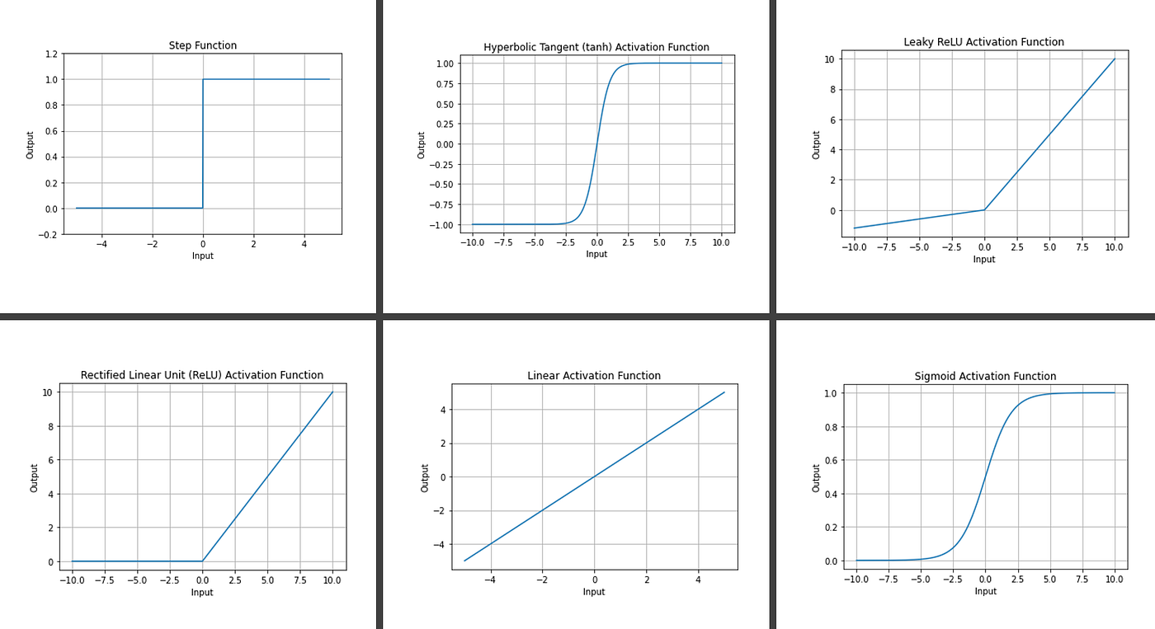
Activation functions

Slide 6
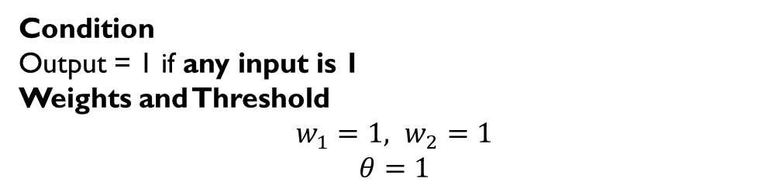
Logic Gates using MP Neuron – Or gate
Condition
Output = 1 if any input is 1
Weights and Threshold
$$w_{1}=1, w_{2}=1$$
$$θ=1$$
x₁ | x₂ | Output | Net
0 | 0 | 0 | 0
0 | 1 | 1 | 1
1 | 0 | 1 | 1
1 | 1 | 1 | 2

Slide 7
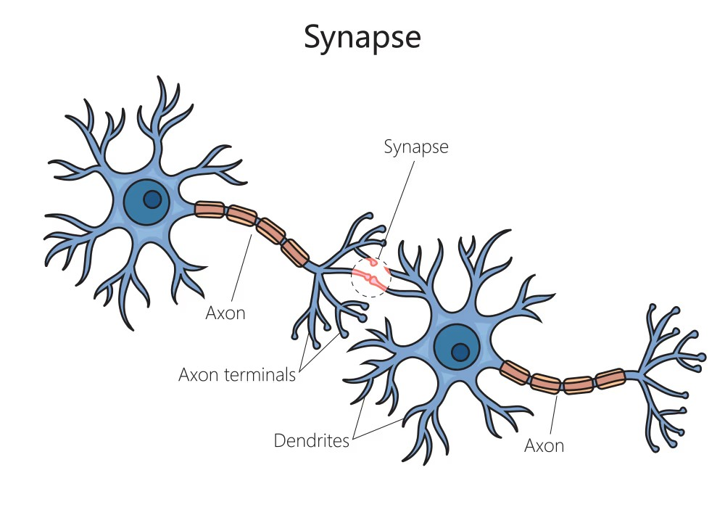
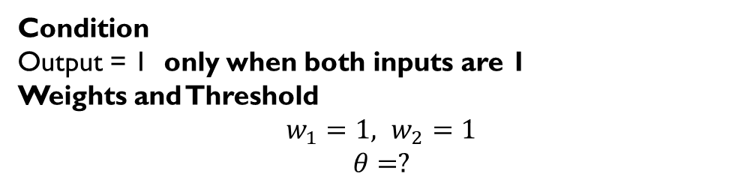
AND gate
Condition
Output = 1 only when both inputs are 1
Weights and Threshold
$$w_{1}=1, w_{2}=1$$
$$θ=?$$
x₁ | x₂ | Output | Net
0 | 0 | 0 | 0
0 | 1 | 0 | 1
1 | 0 | 0 | 1
1 | 1 | 1 | 2

Slide 8
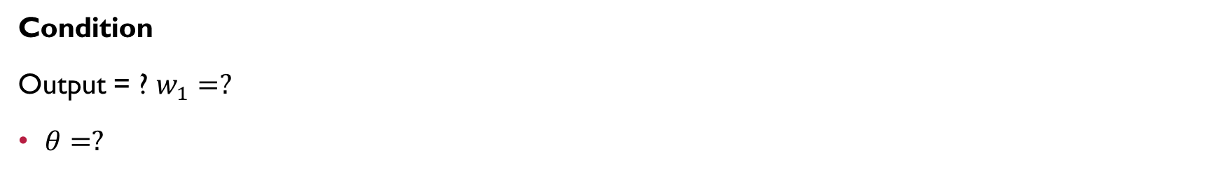
Implement NOT
Condition
Output = ? $w_{1}=?$
$θ=?$
x₁ | Output | Net
0
1

Slide 9
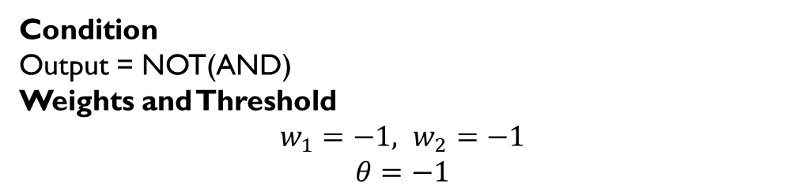
NAND gate
Condition
Output = NOT(AND)
Weights and Threshold
$$w_{1}=−1, w_{2}=−1$$
$$θ=−1$$
x₁ | x₂ | Output | Net
0 | 0 | 1 | 0
0 | 1 | 1 | -1
1 | 0 | 1 | -1
1 | 1 | 0 | -2

